Slide 1
Query Processing I
SEI. ECNU

Slide 2
Basic Steps in Query Processing

Slide 3

Architecture Overview
Networking Layer
SQL Parser
Binder
Rewriter
Optimizer / Cost Models
Planner
Compiler
Access Methods / Indexes
Scheduling / Placement
Concurrency Control
Operator Execution
Execution Engine
Storage Manager
Storage Models
Logging / Checkpoints

Slide 4
Query Execution
A query plan is comprised of operators.
An operator instance is an invocation of an operator on some segment of data.
A task is the execution of a sequence of one or more operator instances.
A DBMS’s process model defines how the system is architected to support concurrent requests from a multi-user application.
A worker is the DBMS component that is responsible for executing tasks on behalf of the client and returning the results.

Slide 5
Process Models
Approach #1: Process per DBMS Worker
Approach #2: Process Pool
Approach #3: Thread per DBMS Worker
Less overhead per context switch.
Don’t have to manage shared memory.

Slide 6
Scheduling
For each query plan, the DBMS has to decide where, when, and how to execute it.
How many tasks should it use?
How many CPU cores should it use?
What CPU core should the tasks execute on?
Where should a task store its output?
The DBMS always knows more than the OS.

Slide 7
Execution Optimization
Improve the DBMS's query execution performance
Especially for data sets that fit entirely in memory
Approach #1: Reduce Instruction Count
Use fewer instructions to do the same amount of work.
Approach #2: Reduce Cycles per Instruction
Execute more CPU instructions in fewer cycles.
Approach #3: Parallelize Execution
Use multiple threads to compute each query in parallel.

Slide 8
Processing Models

Slide 9
Processing Models
A DBMS's processing model defines how the system executes a query plan.
Different trade-offs for workloads (OLTP vs. OLAP).
Approach #1: Iterator Model
Approach #2: Materialization Model
Approach #3: Vectorized / Batch Model

Slide 10
Iterator Model
Each query plan operator implements a next function.
On each invocation, the operator returns either a single tuple or a null marker if there are no more tuples.
The operator implements a loop that calls next on its children to retrieve their tuples and then process them.
Also called Volcano or Pipeline Model.

Slide 11
Iterator Model
Next()
for t in child.Next():
emit(projection(t))
SELECT R.id, S.cdate
FROM R JOIN S ON R.id = S.id
WHERE S.value > 100
Next()
for t1 in left.Next():
buildHashTable(t1)
for t2 in right.Next():
if probe(t2): emit(t1⨝t2)
π
R.id, S.cdate
⋈
R.id=S.id
Next()
for t in child.Next():
if evalPred(t): emit(t)
σ
value>100
Next()
for t in S:
emit(t)
Next()
for t in R:
emit(t)
R
S

Slide 12
Iterator Model
Next()
for t in child.Next():
emit(projection(t))
SELECT R.id, S.cdate
FROM R JOIN S ON R.id = S.id
WHERE S.value > 100
Next()
for t1 in left.Next():
buildHashTable(t1)
for t2 in right.Next():
if probe(t2): emit(t1⨝t2)
π
R.id, S.cdate
⋈
R.id=S.id
Next()
for t in child.Next():
if evalPred(t): emit(t)
σ
value>100
Next()
for t in S:
emit(t)
Next()
for t in R:
emit(t)
R
S
Single Tuple

Slide 13
Iterator Model
Next()
for t in child.Next():
emit(projection(t))
SELECT R.id, S.cdate
FROM R JOIN S ON R.id = S.id
WHERE S.value > 100
Next()
for t1 in left.Next():
buildHashTable(t1)
for t2 in right.Next():
if probe(t2): emit(t1⨝t2)
π
R.id, S.cdate
⋈
R.id=S.id
Next()
for t in child.Next():
if evalPred(t): emit(t)
σ
value>100
Next()
for t in S:
emit(t)
Next()
for t in R:
emit(t)
R
S

Slide 14
Iterator Model
This is used in almost every DBMS. Allows for tuple pipelining.
Some operators must block until their children emit all their tuples.
Joins, Subqueries, Order By, Sorting, …
Output control works easily with this approach.

Slide 15
Materialization Model
Each operator processes its input all at once and then emits its output all at once.
The operator "materializes" it output as a single result.
The DBMS can push down hints into to avoid scanning too many tuples.
Can send either a materialized row or a single column.
The output can be either whole tuples (NSM, n-ary storage model
Row storage) or subsets of columns (DSM, Decomposition Storage Model
)

Slide 16
Materialization Model
out = [ ]
for t in child.Output():
out.add(projection(t))
return out
SELECT R.id, S.cdate
FROM R JOIN S ON R.id = S.id
WHERE S.value > 100
out = [ ]
for t1 in left.Output():
buildHashTable(t1)
for t2 in right.Output():
if probe(t2): out.add(t1⨝t2)
return out
π
R.id, S.cdate
⋈
R.id=S.id
out = [ ]
for t in child.Output():
if evalPred(t): out.add(t)
return out
σ
value>100
out = [ ]
for t in R:
out.add(t)
return out
out = [ ]
for t in S:
out.add(t)
return out
All Tuples
R
S

Slide 17
Materialization Model
out = [ ]
for t in child.Output():
out.add(projection(t))
return out
SELECT R.id, S.cdate
FROM R JOIN S ON R.id = S.id
WHERE S.value > 100
out = [ ]
for t1 in left.Output():
buildHashTable(t1)
for t2 in right.Output():
if probe(t2): out.add(t1⨝t2)
return out
π
R.id, S.cdate
⋈
R.id=S.id
out = [ ]
for t in child.Output():
if evalPred(t): out.add(t)
return out
σ
value>100
out = [ ]
for t in R:
out.add(t)
return out
out = [ ]
for t in S:
out.add(t)
return out
R
S

Slide 18
Materialization Model
out = [ ]
for t in child.Output():
out.add(projection(t))
return out
SELECT R.id, S.cdate
FROM R JOIN S ON R.id = S.id
WHERE S.value > 100
out = [ ]
for t1 in left.Output():
buildHashTable(t1)
for t2 in right.Output():
if probe(t2): out.add(t1⨝t2)
return out
π
R.id, S.cdate
⋈
R.id=S.id
σ
value>100
out = [ ]
for t in R:
out.add(t)
return out
out = [ ]
for t in S:
if evalPred(t): out.add(t)
return out
R
S

Slide 19
Materialization Model
Better for OLTP workloads because queries only access a small number of tuples at a time.
Lower execution / coordination overhead.
Fewer function calls.
Not good for OLAP queries with large intermediate results.

Slide 20
Vectorization Model
Like the Iterator Model where each operator implements a next function.
But each operator emits a batch of tuples instead of a single tuple.
The operator's internal loop processes multiple tuples at a time.
The size of the batch can vary based on hardware or query properties.

Slide 21
Vectorization Model
out = [ ]
for t in child.next():
out.add(projection(t))
if |out|>n: emit out
SELECT R.id, S.cdate
FROM R JOIN S ON R.id = S.id
WHERE S.value > 100
out = [ ]
for t1 in left.next():
buildHashTable(t1)
for t2 in right.next():
if probe(t2): out.add(t1⨝t2)
if |out|>n: emit out
π
R.id, S.cdate
⋈
R.id=S.id
out = [ ]
for t in child.Next():
if evalPred(t): out.add(t)
if |out|>n: emit out
σ
value>100
out = [ ]
for t in R:
out.add(t)
if |out|>n: emit out
out = [ ]
for t in S:
out.add(t)
if |out|>n: emit out
Tuples Batch
R
S

Slide 22
Vectorization Model
out = [ ]
for t in child.next():
out.add(projection(t))
if |out|>n: emit out
SELECT R.id, S.cdate
FROM R JOIN S ON R.id = S.id
WHERE S.value > 100
out = [ ]
for t1 in left.next():
buildHashTable(t1)
for t2 in right.next():
if probe(t2): out.add(t1⨝t2)
if |out|>n: emit out
π
R.id, S.cdate
⋈
R.id=S.id
out = [ ]
for t in child.Next():
if evalPred(t): out.add(t)
if |out|>n: emit out
σ
value>100
out = [ ]
for t in R:
out.add(t)
if |out|>n: emit out
out = [ ]
for t in S:
out.add(t)
if |out|>n: emit out
R
S

Slide 23
Vectorization Model
Ideal for OLAP queries because it greatly reduces the number of invocations per operator.
Allows for operators to use vectorized (SIMD) instructions to process batches of tuples.

Slide 24
Plan Processing Direction
Approach #1: Top-to-Bottom
Start with the root and "pull" data up from its children.
Tuples are always passed with function calls.
Approach #2: Bottom-to-Top
Start with leaf nodes and "push" data to their parents.
Allows for tighter control of caches/registers in pipelines.

Slide 25
Measures of Query Cost
Disk cost can be estimated as:
Number of seeks * average-seek-cost
Number of blocks read * average-block-read-cost
Number of blocks written * average-block-write-cost
We just use the number of block transfers from disk and the number of seeks
t_{T} – time to transfer one block
t_{S} – time for one seek
Cost for b block transfers plus S seeks b * t_{T} + S * t_{S}
t_{S} and t_{T} depend on where data is stored; with 4 KB blocks:
High end magnetic disk: t_{S} = 4 ms and t_{T} =0.1 ms
SSD: t_{S} = 0.02 - 0.09 ms and t_{T} = 0.002 – 0.01 ms for 4KB

Slide 26
Measures of Query Cost
Required data may be buffer resident already, avoiding disk I/O
But hard to take into account for cost estimation
Several algorithms can reduce disk IO by using extra buffer space
Amount of real memory available to buffer depends on other concurrent queries and OS processes, known only during execution
Worst case estimates assume that no data is initially in buffer and only the minimum amount of memory needed for the operation is available
But more optimistic estimates are used in practice

Slide 27
Selection

Slide 28
Access Method
An access method is a way that the DBMS can access the data stored in a table.
Not defined in relational algebra.
Three basic approaches:
Sequential Scan (File Scan)
Index Scan
Multi-Index / "Bitmap" Scan
SELECT R.id, S.cdate
FROM R JOIN S ON R.id = S.id
WHERE S.value > 100
π
R.id, S.cdate
⋈
R.id=S.id
σ
value>100
R
S

Slide 29
Sequential Scan
For each page in the table:
Retrieve it from the buffer pool.
Iterate over each tuple and check whether to include it.
The DBMS maintains an internal cursor that tracks the last page / slot it examined.
for page in table.pages:
for t in page.tuples:
if evalPred(t):
// Do Something!

Slide 30
Sequential Scan Optimizations
This is almost always the worst thing that the DBMS can do to execute a query.
Sequential Scan Optimizations:
Prefetching
Buffer Pool Bypass
Parallelization
Heap Clustering
Zone Maps
Late Materialization

Slide 31
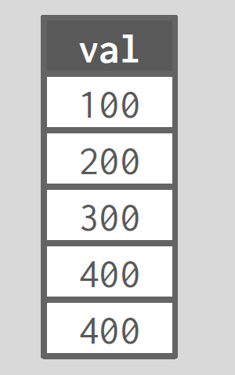
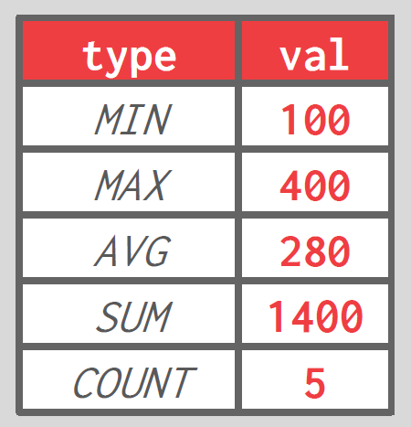

Zone Maps
Pre-computed aggregates for the attribute values in a page.
DBMS checks the zone map first to decide whether it wants to access the page.
Original Data
Zone Map

Slide 32
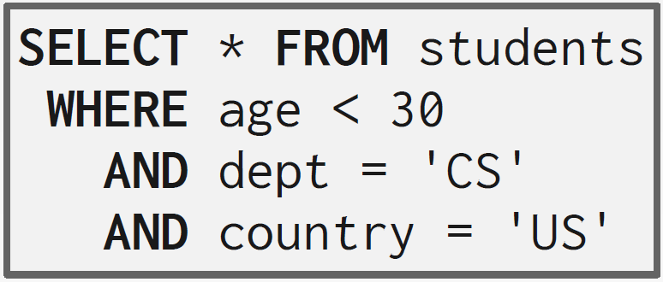
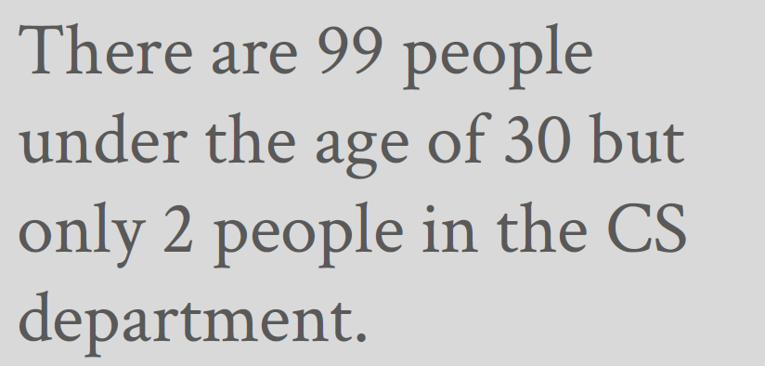
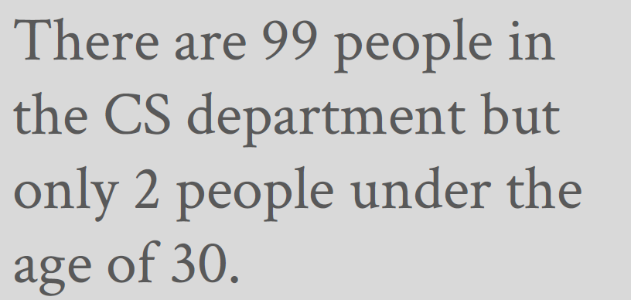
Index Scan
Suppose that we a single table with 100 tuples and two indexes:
Index #1: age
Index #2: dept
Scenario #1
Scenario #2

Slide 33
Multi-Index Scan
If there are multiple indexes that the DBMS can use for a query:
Compute sets of record ids using each matching index.
Combine these sets based on the query's predicates (union vs. intersect).
Retrieve the records and apply any remaining predicates.
PostgresSQL calls this Bitmap Scan.

Slide 34
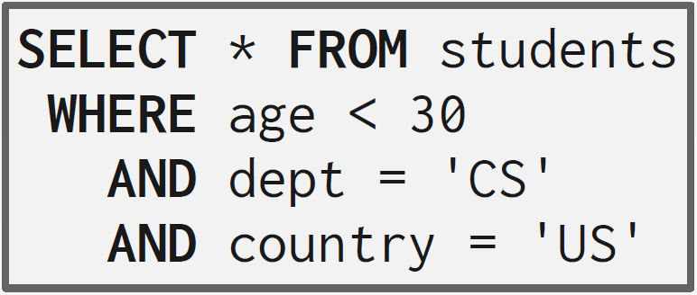
Multi-Index Scan
With an index on age and an index on dept,
We can retrieve the record ids satisfying age<30 using the first,
Then retrieve the record ids satisfying dept='CS' using the second,
Take their intersection
Retrieve records and check country='US'.

Slide 35
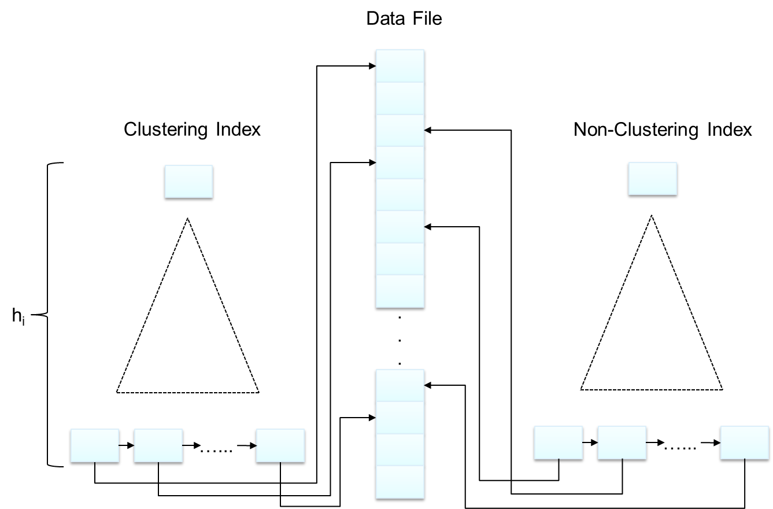

Slide 36
Algorithms
A1: linear search (File Scan)
A2: clustering index, equality on key
A3: clustering index, equality on nonkey
A4: secondary index, equality on key/non-key
A5: clustering index, comparison
A6: non-clustering index, comparison
A7: conjunctive selection using one index
A8: conjunctive selection using composite index
A9: conjunctive selection by intersection of identifiers
A10: disjunctive selection by union of identifiers

Slide 37
Selection
 | no index | clustering index | secondary index
equality on key σ_{key=V} (r) | b_{r}*t_{T}+t_{S} (b_{r} /2)*t_{T}+t_{S} | (h_{i}+1) * (t_{T}+t_{S})
equality on nonkey σ_{non-key=V} (r) |  | h_{i}*(t_{T}+t_{S})+t_{S}+t_{T}*b | (h_{i}+n)*(t_{T}+t_{S})
Comparison σ_{A≥V} (r) | σ_{A≤V} (r) |  | h_{i}*(t_{T}+t_{S})+t_{S}+t_{T}*b t_{S}+t_{T}*b | (h_{i}+n) * (t_{T}+t_{S})
Conjunction σ_{θ1∧ θ2∧. . . θn}(r) |  | min{ σ_{θi}(r) }
Disjunction σ_{θ1∨ θ2 ∨. . . θn} (r) |  | Σσ_{θi}(r)
Negation σ_{¬θ}(r) |  | (h_{i}+1) * (t_{T}+t_{S})

Slide 38
Sorting

Slide 39
Why do we need to sort?
Queries may request that tuples are sorted in a specific way (ORDER BY).
But even if a query does not specify an order, we may still want to sort to do other things:
Trivial to support duplicate elimination (DISTINCT).
Bulk loading sorted tuples into a B+Tree index is faster.
Aggregations (GROUP BY).

Slide 40
Sorting Algorithms
If data fits in memory, then we can use a standard sorting algorithm like quick-sort.
If data does not fit in memory, then we need to use external merge sort
Divide-and-conquer algorithm that splits the data set into separate runs, sorts them individually, and then combine into larger sorted runs.
Phase #1 – Sorting
Sort blocks of data that fit in main-memory and then write back the sorted blocks to a file on disk.
Phase #2 – Merging
Combine sorted sub-files into a single larger file.

Slide 41
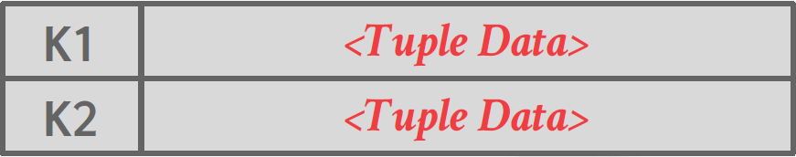
Sorted Runs
A run is a list of key/value pairs.
Key: The attribute(s) to compare to compute the sort order.
Value: Two choices
Record Id (late materialization).
Tuple (early materialization).
Early Materialization
Late Materialization

Slide 42
2-Way External Merge Sort
In each pass, we read and write each page in file.
Number of passes= 1 + ⌈log₂b_{r}⌉
Total I/O cost= 2N∙(# of passes)-b_{r}
3, 4
6, 2
9, 4
8, 7
5, 6
3, 1
2
EOF
PASS #0
3, 4
2, 6
4, 9
7, 8
5, 6
1, 3
2
EOF
PASS #1
2, 3
4, 7
1, 3
2
4, 6
8, 9
5, 6
EOF
PASS #2
2, 3
1, 2
4, 4
3, 5
Only requires three buffer pages
6, 7
6
8, 9
EOF
PASS #3
1, 2
2, 3
3, 4
4, 5
6, 6
7, 8
9
EOF

Slide 43
General External Merge Sort
Pass #0
Use B buffer pages.
Produce ⌈b_{r}/B⌉ sorted runs of size B
Pass #1,2,3,…
Merge B-1 runs (i.e., K-way merge).
Number of passes = 1 + ⌈ log_{B-1} ⌈b_{r}/B⌉ ⌉
Total I/O Cost = 2b_{r} ∙ (# of passes) - b_{r}
b_{r}(2 ⎡log_{B–1}(b_{r} /B)⎤ + 1) block transfers
2⎡b_{r}/B⎤ + b_{r} (2 ⎡log_{B–1}(b_{r} /B)⎤ -1) seeks

Slide 44
Example
Determine how many passes it takes to sort 108 pages with 5 buffer pages: N=108, B=5
Pass #0: ⌈N/B⌉ = ⌈108/5⌉ = 22 sorted runs of 5 pages each (last run is only 3 pages).
Pass #1: ⌈N’/(B-1)⌉ = ⌈22/4⌉ = 6 sorted runs of 20 pages each (last run is only 8 pages).
Pass #2: ⌈N’’/(B-1)⌉ = ⌈6/4⌉ = 2 sorted runs, first one has 80 pages and second one has 28 pages.
Pass #3: Sorted file of 108 pages.
1+⌈ log_{B-1}^{⌈N/B⌉} ⌉ = 1+⌈log₄²²⌉ = 1+⌈2.229...⌉= 4 passes

